Slide 1

Lecture 8 Mathematics of Data: ISOMAP and LLE
姚 远
2011.4.12

Slide 2
John Dewey
If knowledge comes from the impressions made upon us by natural objects, it is impossible to procure knowledge without the use of objects which impress the mind.
Democracy and Education: an introduction to the philosophy of education, 1916

Slide 3
Matlab Dimensionality Reduction Toolbox
http://homepage.tudelft.nl/19j49/Matlab_Toolbox_for_Dimensionality_Reduction.html
Math.pku.edu.cn/teachers/yaoy/Spring2011/matlab/drtoolbox
Principal Component Analysis (PCA), Probabilistic PC
Factor Analysis (FA), Sammon mapping, Linear Discriminant Analysis (LDA)
Multidimensional scaling (MDS), Isomap, Landmark Isomap
Local Linear Embedding (LLE), Laplacian Eigenmaps, Hessian LLE, Conformal Eigenmaps
Local Tangent Space Alignment (LTSA), Maximum Variance Unfolding (extension of LLE)
Landmark MVU (LandmarkMVU), Fast Maximum Variance Unfolding (FastMVU)
Kernel PCA
Diffusion maps
…

Slide 4
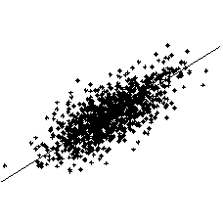
Recall: PCA
Principal Component Analysis (PCA)
One Dimensional
Manifold

Slide 5
Recall: MDS
Given pairwise distances D, where D_{ij} = d_{ij}², the squared distance between point i and j
Convert the pairwise distance matrix D (c.n.d.) into the dot product matrix B (p.s.d.)
B_{ij} (a) = -.5 H(a) D H’(a), Hölder matrix H(a) = I-1a’;
a = 1_{k}: B_{ij} = -.5 (D_{ij} - D_{ik} – D_{jk})
a = 1/n:
Eigendecomposition of B = YY^{T}
If we preserve the pairwise Euclidean distances do we preserve the structure??

Slide 6
Nonlinear Manifolds..
A
PCA and MDS see the Euclidean
distance
What is important is the geodesic distance
Unfold the manifold

Slide 7
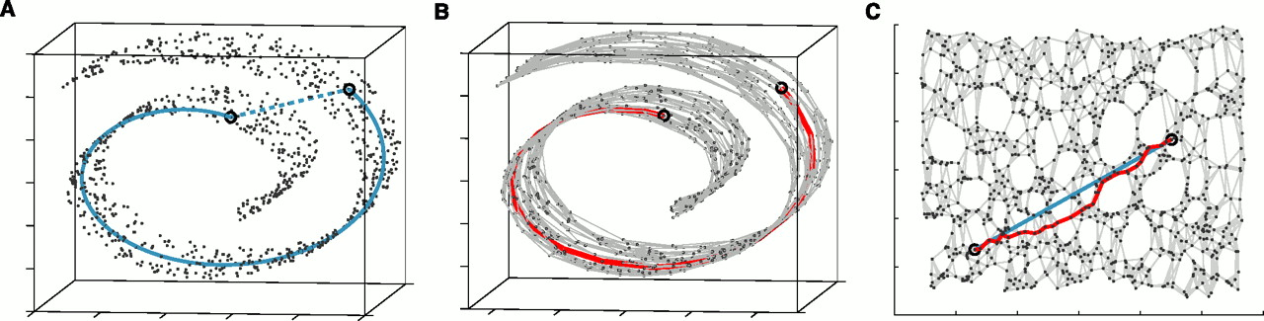
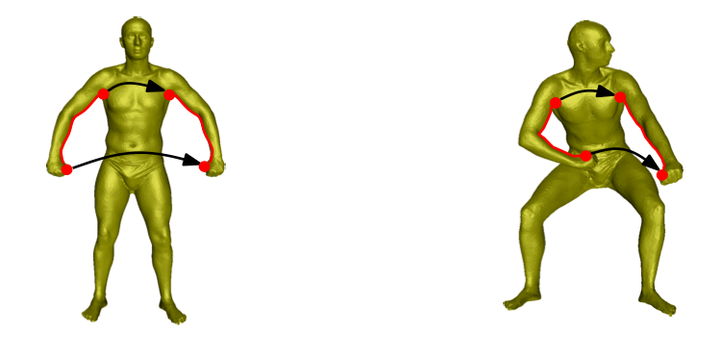
Intrinsic Description..
To preserve structure, preserve the geodesic distance and not the Euclidean distance.

Slide 8
Two Basic Geometric Embedding Methods
Tenenbaum-de Silva-Langford Isomap Algorithm
Global approach.
On a low dimensional embedding
Nearby points should be nearby.
Faraway points should be faraway.
Roweis-Saul Locally Linear Embedding Algorithm
Local approach
Nearby points nearby

Slide 9
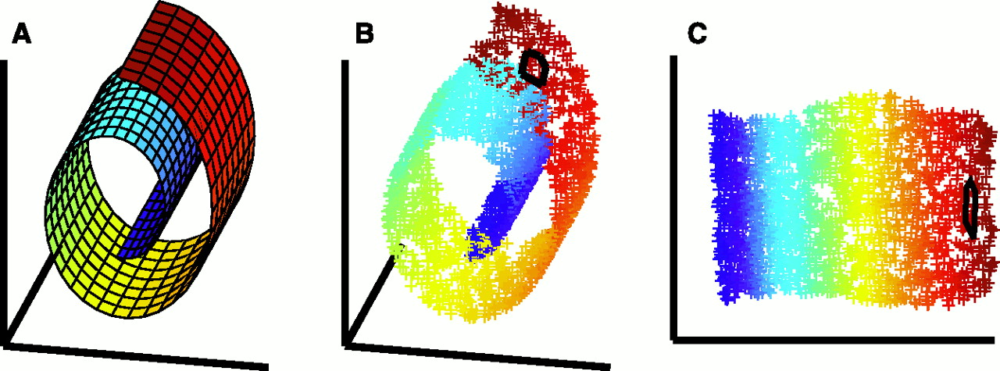
Isomap
Estimate the geodesic distance between faraway points.
For neighboring points Euclidean distance is a good approximation to the geodesic distance.
For faraway points estimate the distance by a series of short hops between neighboring points.
Find shortest paths in a graph with edges connecting neighboring data points
Once we have all pairwise geodesic distances use classical metric MDS

Slide 10
Isomap - Algorithm
Determine the neighbors.
All points in a fixed radius.
K nearest neighbors
Construct a neighborhood graph.
Each point is connected to the other if it is a K nearest neighbor.
Edge Length equals the Euclidean distance
Compute the shortest paths between two nodes
Floyd’s Algorithm (O(N³))
Dijkstra’s Algorithm (O(kN²logN))
Construct a lower dimensional embedding.
Classical MDS

Slide 11
Isomap

Slide 12
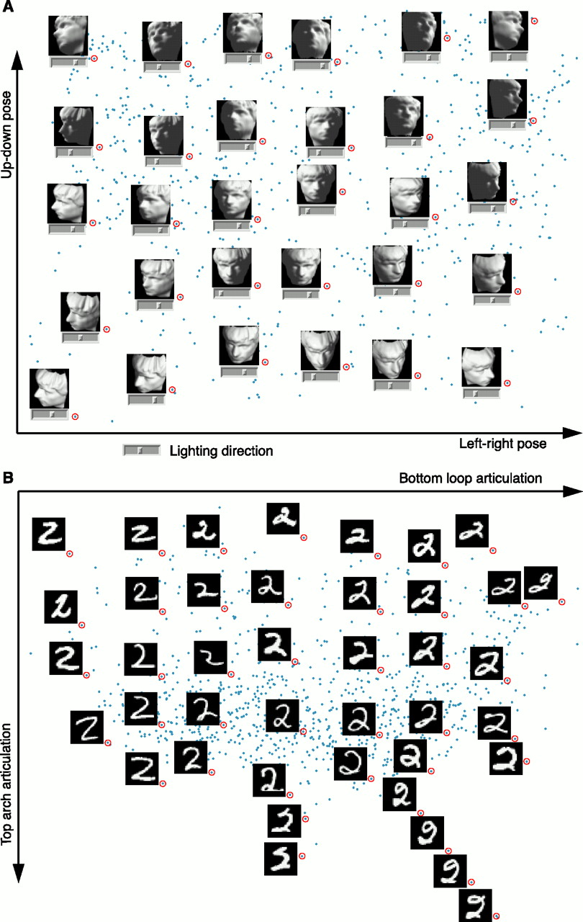
Example…

Slide 13
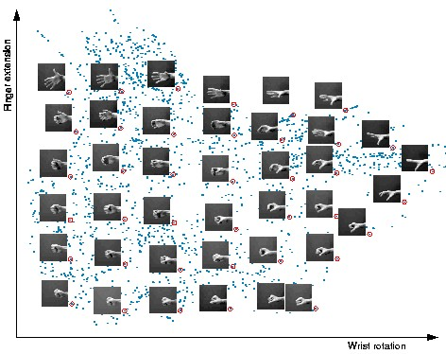

Slide 15
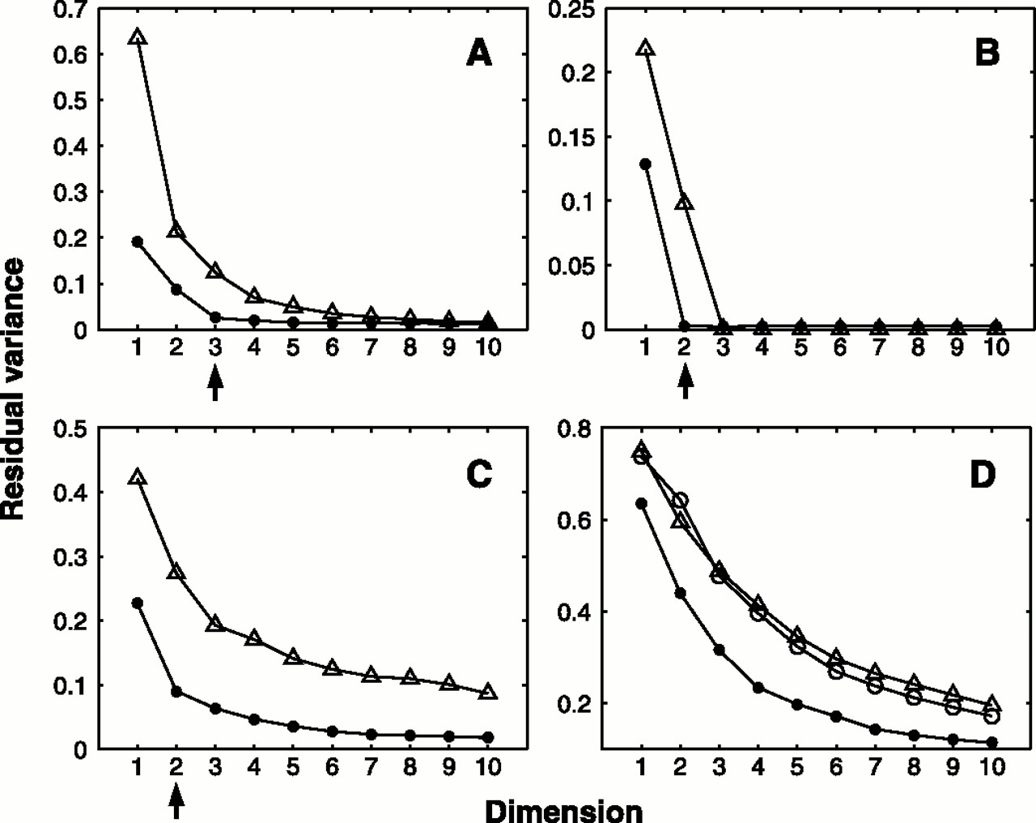
Residual Variance
Face Images
SwisRoll
Hand Images
2

Slide 16
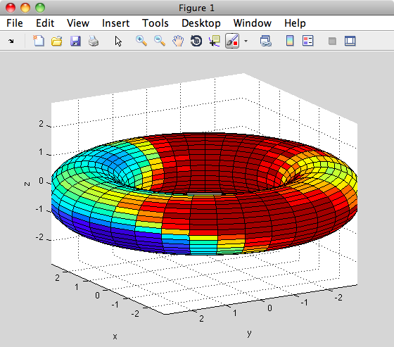
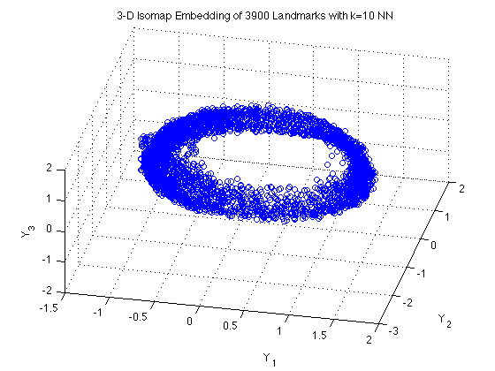
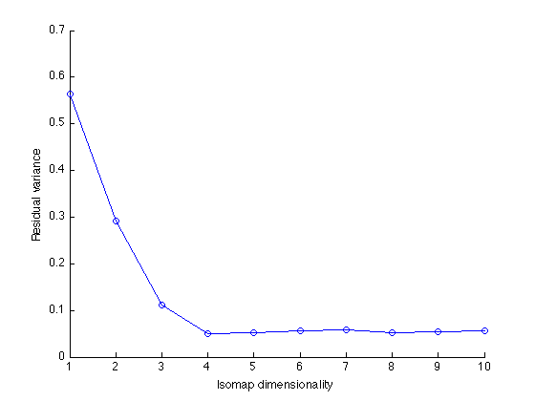
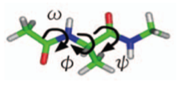
ISOMAP on Alanine-dipeptide
ISOMAP 3D embedding with RMSD metric on 3900 Kcenters

Slide 17
Theory of ISOMAP
ISOMAP has provable convergence guarantees;
Given that {x_{i}} is sampled sufficiently dense, ISOMAP will approximate closely the original distance as measured in manifold M;
In other words, actual geodesic distance approximations using graph G can be arbitrarily good;
Let’s examine these theoretical guarantees in more detail …

Slide 18
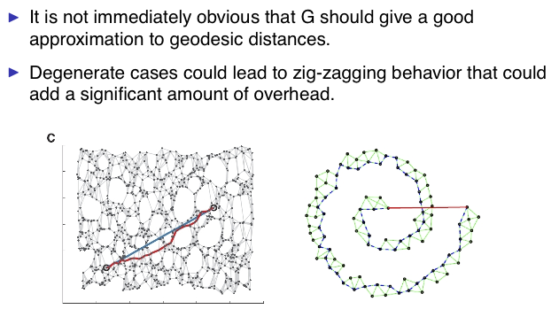
Possible Issues

Slide 19
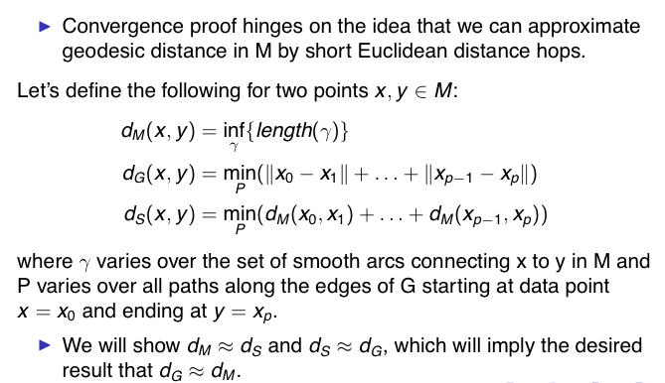
Two step approximations

Slide 20
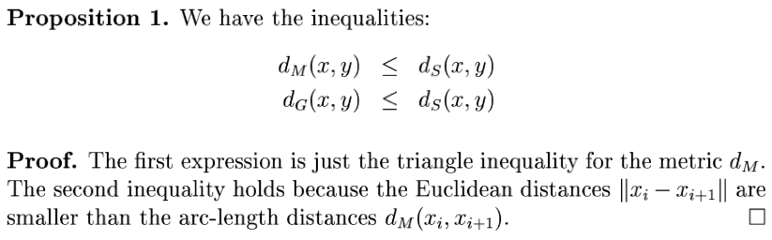

Slide 21
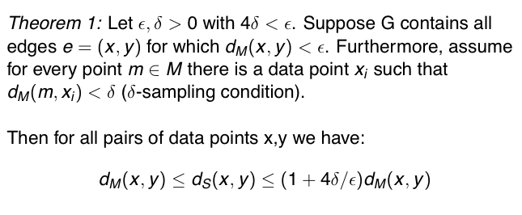
Dense-sampling Theorem [Bernstein, de Silva, Langford, and Tenenbaum 2000]

Slide 22
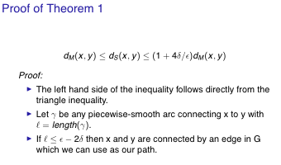
Proof

Slide 23
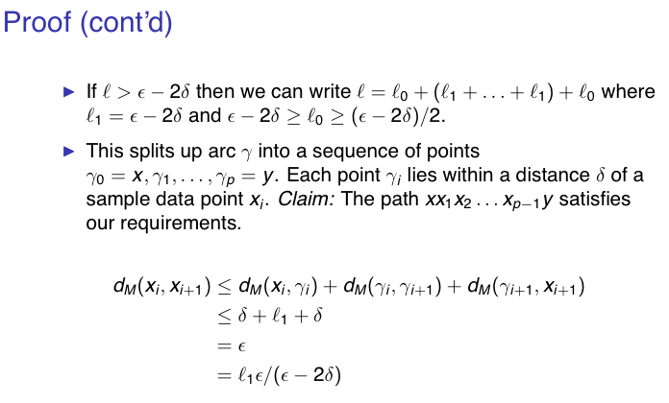
Proof

Slide 24
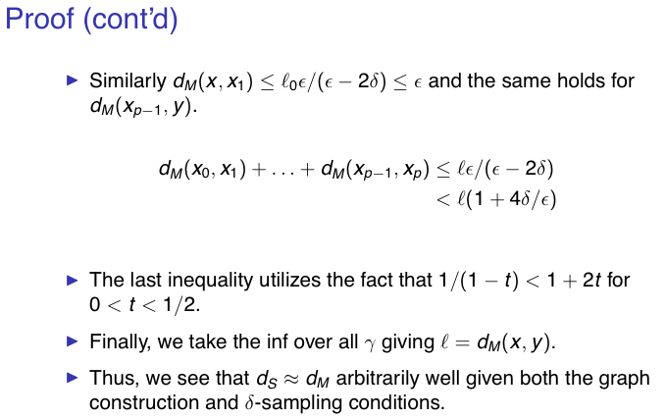
Proof

Slide 25
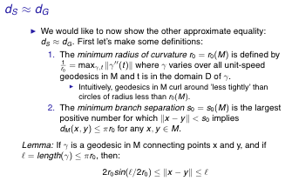
The Second Approximation

Slide 26
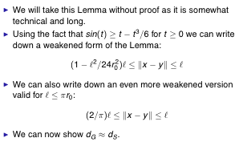
Remarks

Slide 27
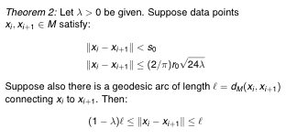
Theorem 2 [Bernstein, de Silva, Langford, and Tenenbaum 2000]

Slide 28
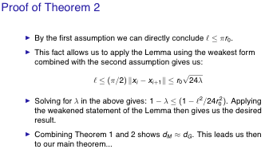
Proof

Slide 29
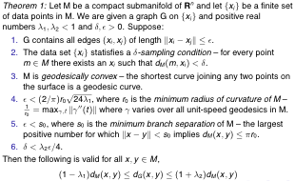
Main Theorem [Bernstein, de Silva, Langford, and Tenenbaum 2000]

Slide 30
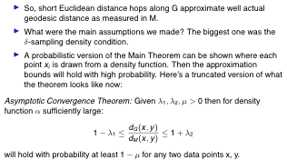
Probabilistic Result

Slide 31
A Shortcoming of ISOMAP
One need to compute pairwise shortest path between all sample pairs (i,j)
Global
Non-sparse
Cubic complexity O(N³)

Slide 32
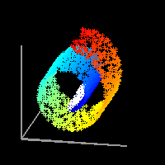
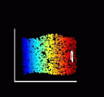
Locally Linear Embedding
manifold is a topological space which is locally Euclidean.”
Fit Locally, Think Globally

Slide 33
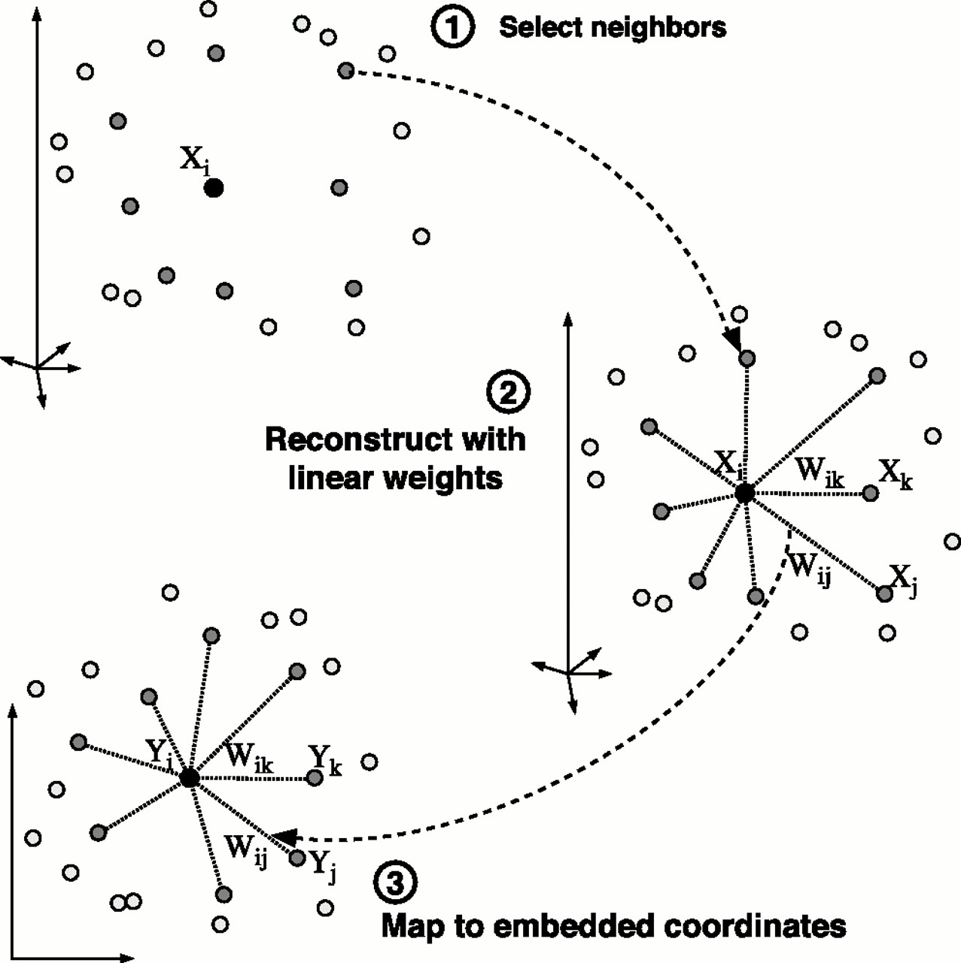
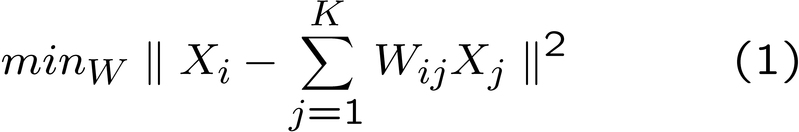
Fit Locally…
We expect each data point and its
neighbours to lie on or close
to a locally linear patch of the
manifold.
Each point can be written as a linear combination of its neighbors.
The weights choosen to
minimize the reconstruction
Error.
Derivation on board

Slide 34
Important property...
The weights that minimize the reconstruction errors are invariant to rotation, rescaling and translation of the data points.
Invariance to translation is enforced by adding the constraint that the weights sum to one.
The same weights that reconstruct the datapoints in D dimensions should reconstruct it in the manifold in d dimensions.
The weights characterize the intrinsic geometric properties of each neighborhood.

Slide 35
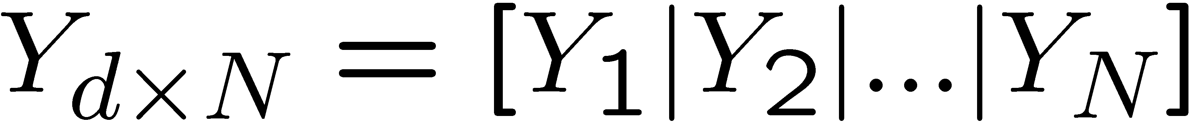
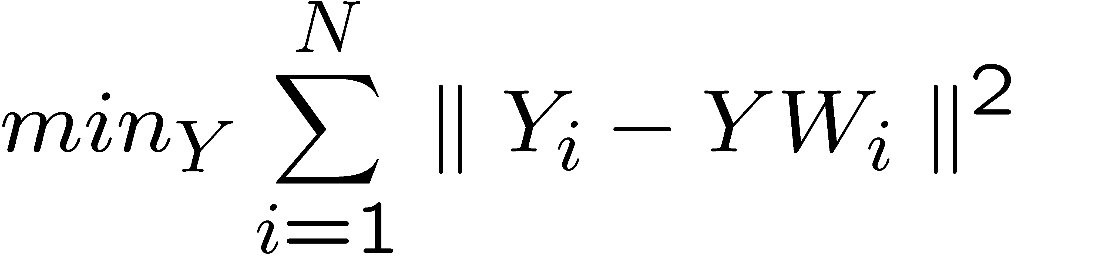
Think Globally…

Slide 36
Algorithm (K-NN)
Local fitting step (with centering):
Consider a point x_{i}
Choose its K(i) neighbors η_{j} whose origin is at x_{i}
Compute the (sum-to-one) weights w_{ij} which minimizes
Contruct neighborhood inner product:
Compute the weight vector w_{i}=(w_{ij}), where 1 is K-vector of all-one and λ is a regularization parameter
Then normalize w_{i} to a sum-to-one vector.

Slide 37
Algorithm (K-NN)
Local fitting step (without centering):
Consider a point x_{i}
Choose its K(i) neighbors x_{j}
Compute the (sum-to-one) weights w_{ij} which minimizes
Contruct neighborhood inner product:
Compute the weight vector w_{i}=(w_{ij}), where

Slide 38
Algorithm continued
Global embedding step:
Construct N-by-N weight matrix W:
Compute d-by-N matrix Y which minimizes
Compute:
Find d+1 bottom eigenvectors of B, v_{n},v_{n-1},…,v_{n-d}
Let d-dimensional embedding Y =[ v_{n-1},v_{n-2},…v_{n-1}]

Slide 39
Remarks on LLE
Searching k-nearest neighbors is of O(kN)
W is sparse, kN/N^2=k/N nozeros
W might be negative, additional nonnegative constraint can be imposed
B=(I-W)^{T}(I-W) is positive semi-definite (p.s.d.)
Open Problem: exact reconstruction condition?

Slide 40
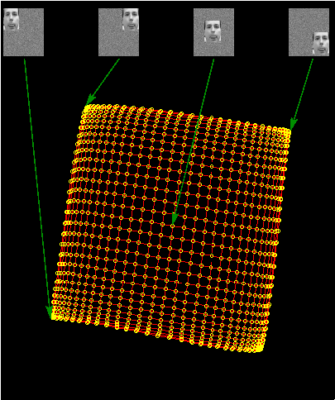

Slide 41
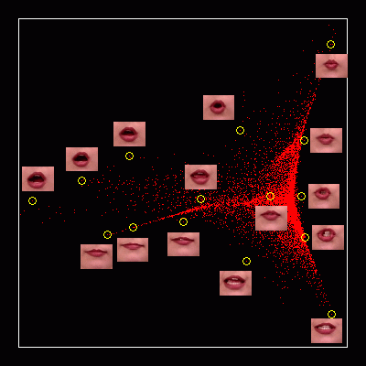

Slide 42
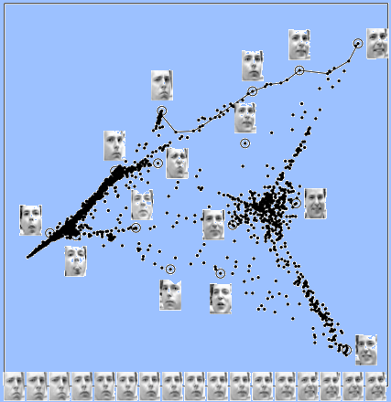

Slide 43
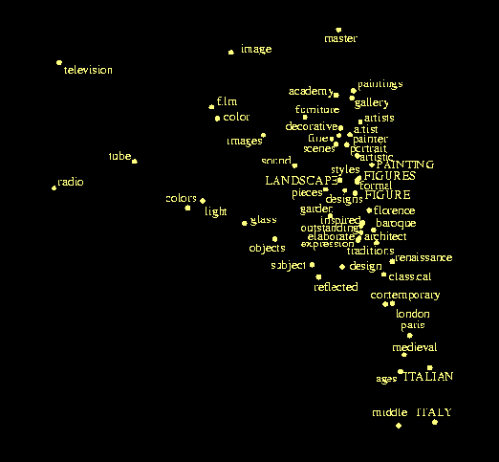
Grolliers Encyclopedia

Slide 44
Summary..
ISOMAP | LLE
Do MDS on the geodesic distance matrix. | Model local neighborhoods as linear a patches and then embed in a lower dimensional manifold.
Global approach | Local approach
Might not work for nonconvex manifolds with holes | Nonconvex manifolds with holes
Extensions: Landmark, Conformal & Isometric ISOMAP | Extensions: Hessian LLE, Laplacian Eigenmaps etc.
Both needs manifold finely sampled.

Slide 45
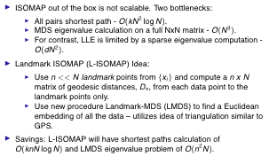
Landmark (Sparse) ISOMAP

Slide 46
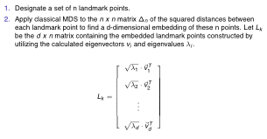
Landmark MDS (Restriction)

Slide 47
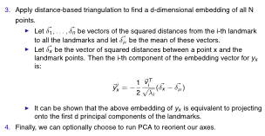
LMDS (Extension)

Slide 48
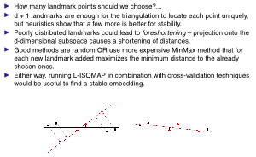
Landmark Choice

Slide 49
Further exploration yet…
Hierarchical landmarks: cover-tree
Nyström method

Slide 50
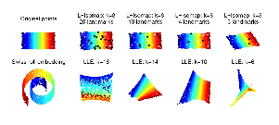
L-ISOMAP Examples

Slide 51
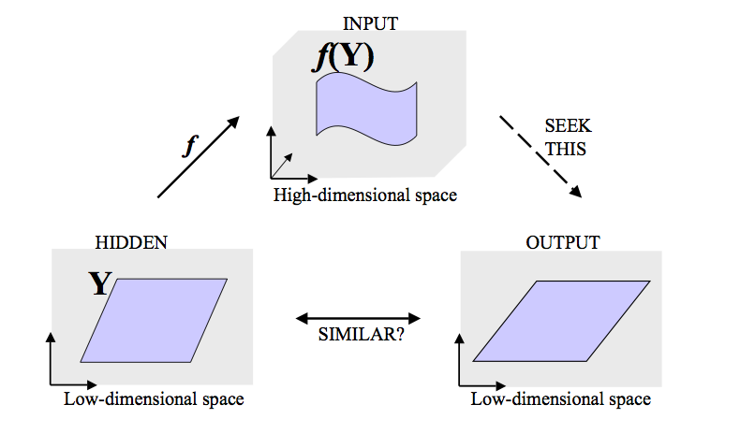
Generative Models in Manifold Learning

Slide 52
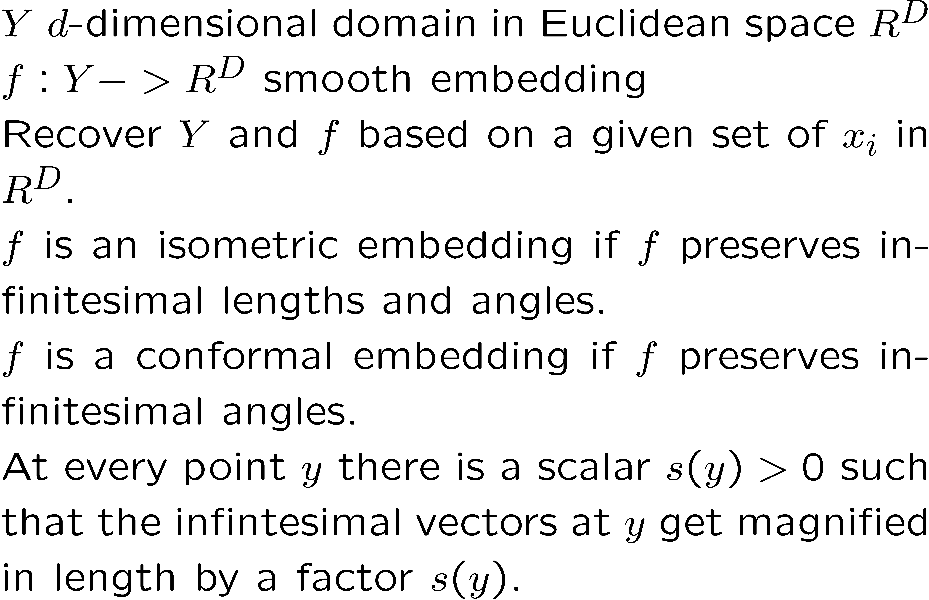
Conformal & Isometric Embedding

Slide 53
Isometric and Conformal
Isometric mapping
Intrinsically flat manifold
Invariants
Geodesic distances are reserved.
Metric space under geodesic distance.
Conformal Embedding
Locally isometric upto a scale factor s(y)
Estimate s(y) and rescale.
C-Isomap
Original data should be uniformly dense

Slide 54
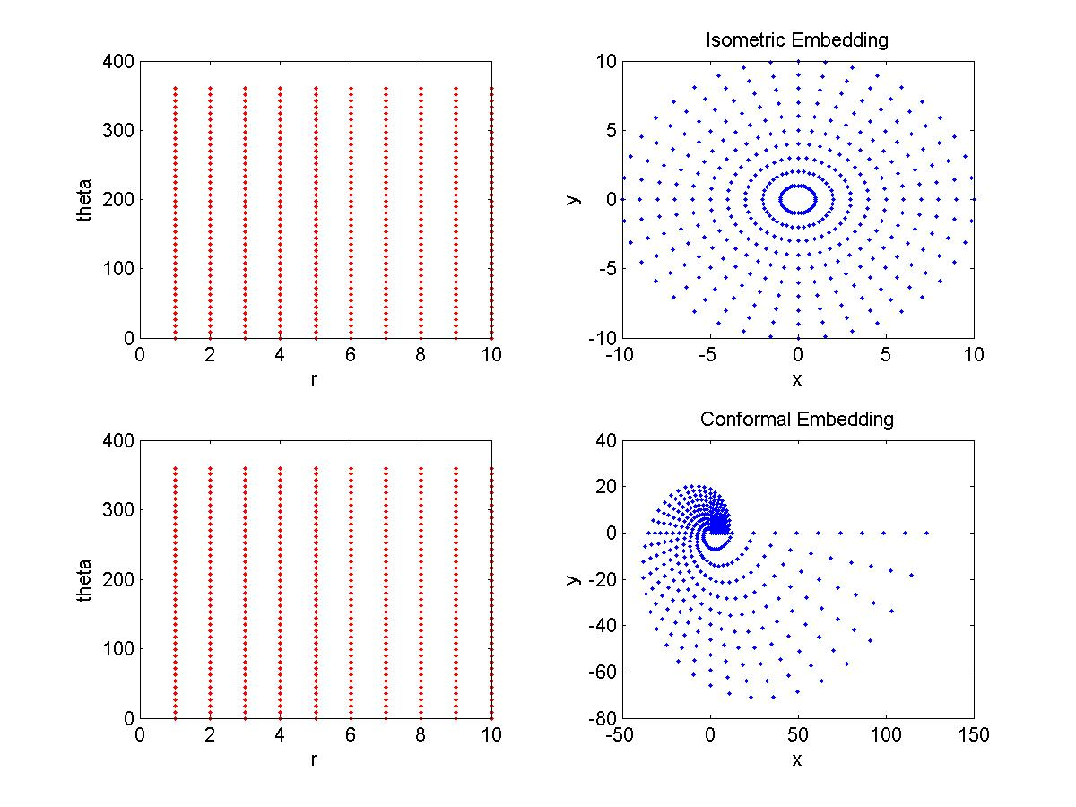

Slide 55
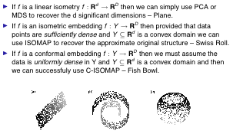
Linear, Isometric, Conformal

Slide 56
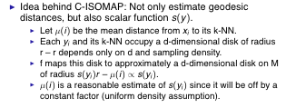
Conformal Isomap

Slide 57
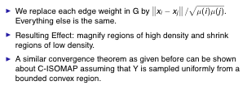
C-Isomap

Slide 58
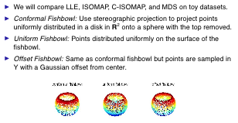
C-Isomap Example I

Slide 59
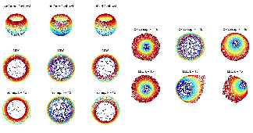
C-Isomap Example I

Slide 60
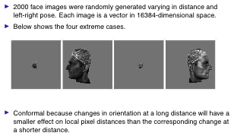
C-Isomap Example II

Slide 61
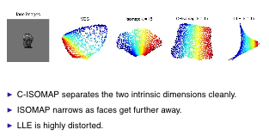
C-Isomap Example II

Slide 62
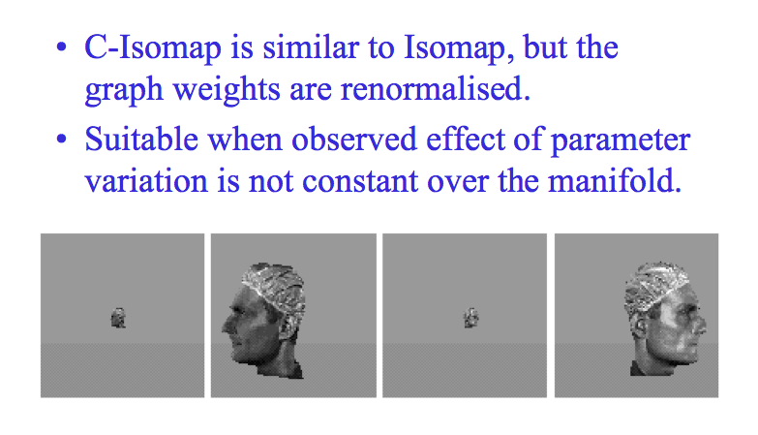
Remark

Slide 63

Recap and Problems

Slide 64
Reference
Tenenbaum, de Silva, and Langford, A Global Geometric Framework for Nonlinear Dimensionality Reduction. Science 290:2319-2323, 22 Dec. 2000.
Roweis and Saul, Nonlinear Dimensionality Reduction by Locally Linear Embedding. Science 290:2323-2326, 22 Dec. 2000.
M. Bernstein, V. de Silva, J. Langford, and J. Tenenbaum. Graph Approximations to Geodesics on Embedded Manifolds. Technical Report, Department of Psychology, Stanford University, 2000.
V. de Silva and J.B. Tenenbaum. Global versus local methods in nonlinear dimensionality reduction. Neural Information Processing Systems 15 (NIPS’2002), pp. 705-712, 2003.
V. de Silva and J.B. Tenenbaum. Unsupervised learning of curved manifolds. Nonlinear Estimation and Classification, 2002.
V. de Silva and J.B. Tenenbaum. Sparse multidimensional scaling using landmark points. Available at: http://math.stanford.edu/~silva/public/publications.html

Slide 65
Acknowledgement
Slides stolen from Ettinger, Vikas C. Raykar,Vin de Silva.

